Slide 1
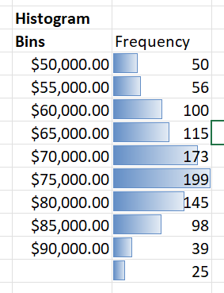
The Initiative leads to much higher profits
the probability that we’ll be able to meet a $50,000 annual profit is the average of the frequencies above 50,000
As the overhead rate increases the profit decreases

Slide 2
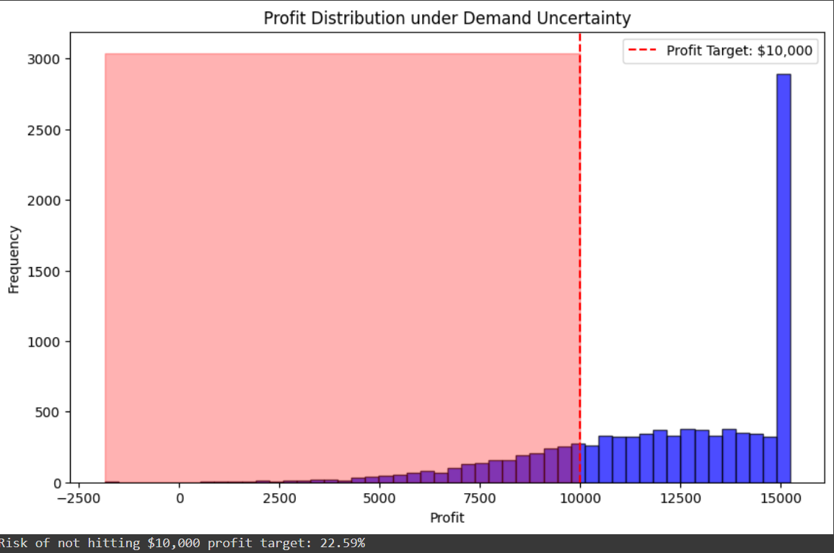
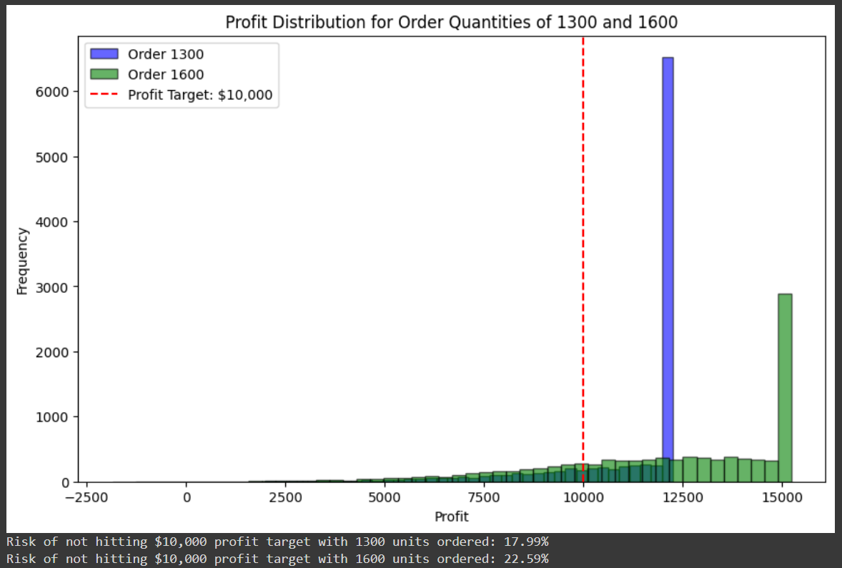
Under this demand uncertainty, what’s the risk of us not hitting that $10,000 profit target?
Risk of not hitting $10,000 profit target: 22.59%
The default order quantity in the model is 1600. How does the risk of not hitting the $10,000 profit target change if we decide to order 1300 instead?
Risk of not hitting $10,000 profit target with 1300 units ordered: 17.99%
Risk of not hitting $10,000 profit target with 1600 units ordered: 22.59%

